Slide 1
Cytoauto clustering presentation
Semi supervise model for unlabeled data prediction
CytoAuto Cluster is a machine learning project focused on developing a semi-supervised deep clustering model for analyzing cytometry data. By accurately identifying cell populations in complex biological data, this project aims to improve clustering interpretability and enhance the reliability of automated cytometry analysis. This method holds potential for applications in biomedical research and healthcare."

Slide 2
Dataset information
Key Columns and Their Descriptions:
Time: Captures the time point of the measurement.
Cell Length: Refers to the measured length of each cell
Feature Columns: These include biological markers like CD45RA, CD133, CD19, and CD22, which measure protein expressions on the cell surface. These markers provide insights into cell characteristics.
Viability: A feature indicating cell viability, potentially used for filtering live cells.
File Number and Event Number: Unique identifiers for each file and specific events within the data.
Label and Individual: Provide labeling information and identifiers for different individuals in the dataset.
Dataset Overview: The dataset contains 265,626 rows and 42 columns, each representing different measurements and features related to cytometry analysis.
Dataset Purpose and Relevance: This dataset is essential for clustering cell populations based on their surface markers, enabling the identification of biologically meaningful groups. The availability of both labeled and unlabeled data supports the semi-supervised learning approach for clustering.
.

Slide 3
model
Spliting of dataset into label and unlabel dataset:
The purpose of this step is to prepare labeled and unlabeled datasets for a self-supervised learning task
The label_column specifies which column in the dataset contains the labels (e.g., the category or outcome you want to predict). This allows for splitting data into labeled and unlabeled groups.
Training of logistic regression and xgboost on label dataset
What is Logistic Regression?
Logistic Regression is a statistical method for binary or multiclass classification problems. It predicts the probability of an outcome (dependent variable) based on one or more input features (independent variables). Unlike linear regression, which predicts continuous values, logistic regression predicts the probability of a class or event by applying the logistic function (also known as the sigmoid function).
P(y=1∣x)= 1 / 1+e−(w0​+w1​x1​+w2​x2​+⋯+wn​xn​)1
XGBoost (Extreme Gradient Boosting)
XGBoost is a powerful and efficient implementation of Gradient Boosting (GB). Gradient boosting is an ensemble learning technique where multiple weak learners (typically decision trees) are combined to form a stronger predictive model. XGBoost enhances the basic gradient boosting algorithm by adding several optimizations:
Log Loss= 1/N i=1∑N​ ​[yi​⋅log(pi​)+(1−yi​)⋅log(1−pi​)]

Slide 4
Encoder model
The self-supervised encoder model is designed to learn meaningful representations of unlabeled data by using a corruption-and-reconstruction paradigm. This approach uses masking to introduce noise into the input data and then trains the model to estimate both the masked regions and reconstruct the original features. The model consists of a neural network with two parallel output layers, optimized with two separate loss functions: one for mask estimation and another for feature reconstruction.
Masking and Corruption
Masking: A binary mask is generated using a given masking probability (p_m). Each mask value determines whether the corresponding feature in the input data is replaced with a shuffled value.
Corruption: Features are replaced with shuffled values based on the binary mask, introducing structured noise into the data.
Loss Functions
Binary Cross-Entropy: Used for the mask estimation task, ensuring accurate prediction of the binary mask.
Mean Squared Error (MSE): Used for the feature reconstruction task, ensuring the model can accurately restore the original unmasked data.
Training
The model is trained using two weighted loss functions with the feature estimation loss weighted by a tunable parameter, alpha.
Input data is corrupted, and the model is trained to predict the mask and reconstruct the uncorrupted data simultaneously.

Slide 5
Semi supervise model
This semi-supervised learning framework combines labeled and unlabeled data to train a classification model. It leverages a pre-trained encoder for feature representation and uses both supervised and unsupervised objectives during training. The model employs an iterative optimization process where the supervised loss (on labeled data) and an unsupervised loss (on unlabeled data) are minimized.
Custom Model Architecture
A fully connected neural network built with TensorFlow/Keras.
Inputs: Encoded features from the pre-trained encoder.
Hidden Layers: Two dense layers with customizable dimensions and activation functions.
Logit Layer: Produces unscaled logits for classification.
Softmax Layer: Converts logits into probabilities for class predictions
Apllication
Leveraging large quantities of unlabeled data in the presence of limited labeled data.
Improving generalization by incorporating unsupervised objectives.

Slide 6
Tsne visualization
Purpose: t-SNE is a dimensionality reduction technique primarily used to visualize high-dimensional data in 2D or 3D space.
High-Dimensional Similarity: In the original high-dimensional space, t-SNE computes pairwise similarities between data points using a Gaussian distribution. Points that are close in this space are given higher similarity values.
Low-Dimensional Similarity:In the lower-dimensional space (e.g., 2D or 3D), t-SNE tries to represent these similarities using a Student-t distribution. This distribution places more emphasis on preserving local structure while allowing distant points to be modeled more flexibly.
Cost Function Optimization:t-SNE minimizes a cost function (Kullback-Leibler divergence) that measures the difference between the high-dimensional and low-dimensional similarities. The result is a lower-dimensional representation where similar points are grouped together.
Advantages
Intuitive Clustering:t-SNE often results in well-separated clusters, making it easy to interpret and identify distinct groups in the data.
Visualization of High-Dimensional Data:Useful for datasets where features are not easily interpretable or when dimensionality is too high for direct visualization.
Effective for Semi-Supervised Learning:Helps visualize relationships between labeled and unlabeled data.

Slide 7
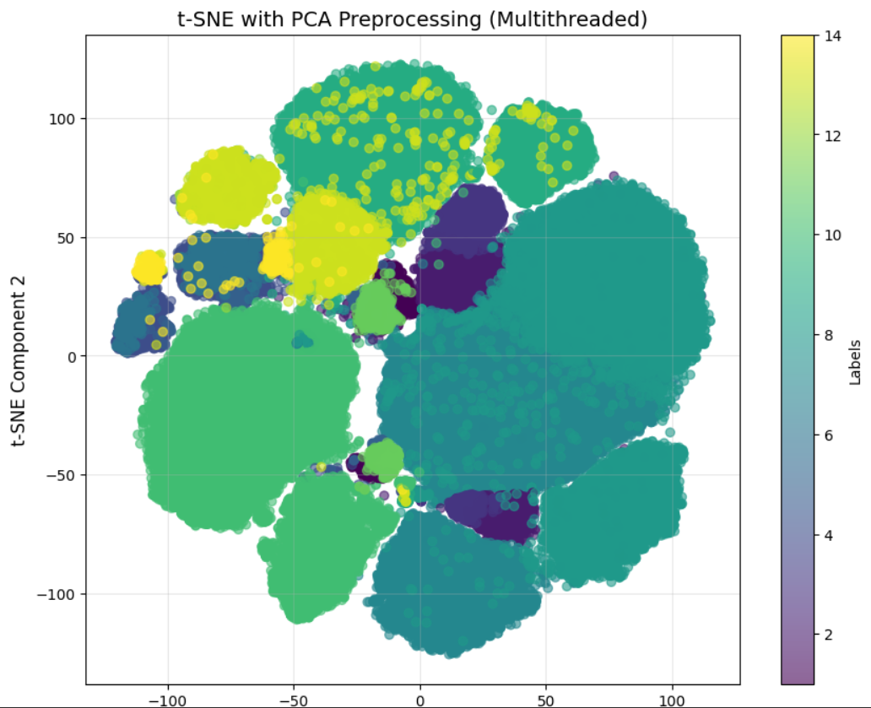
Tsne of label dataset
Visualization:
A scatter plot visualizes the data points, color-coded by their labels.
The colorbar represents different labels, while the plot highlights how well-separated or clustered the labeled data is in the 2D space.
This approach combines PCA and t-SNE for efficient and interpretable clustering of labeled datasets, offering insights into the dataset's structure.
Clusters indicate how similar data points group together based on their features.
Colors (mapped by labels) show the distribution of the labeled categories.
Separation of clusters suggests clear boundaries between categories, while overlaps might indicate ambiguities or similarities between certain classes.

Slide 8
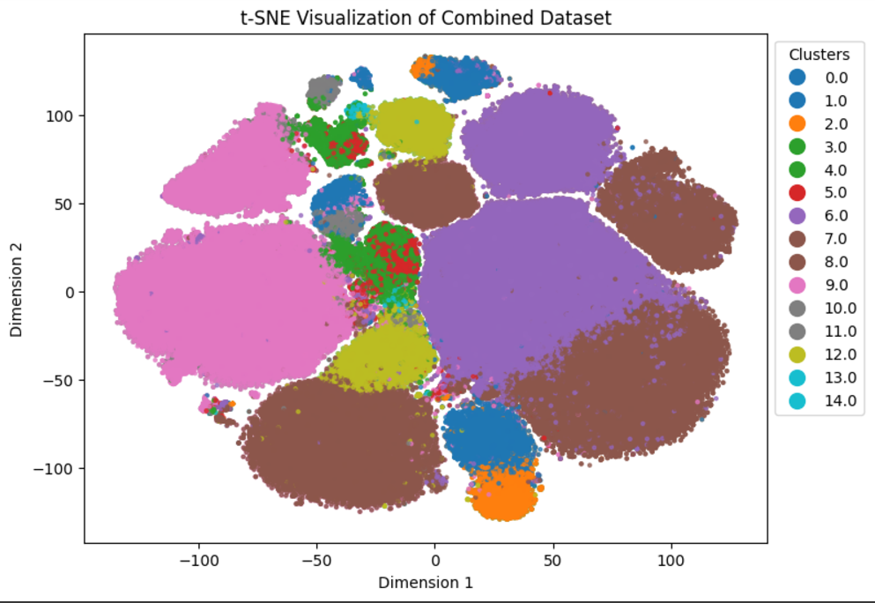
Tsne for label and unlabeled dataset
Dataset Combination:Combines labeled and unlabeled data with their respective labels or predictions to form a unified dataset.
t-SNE Visualization:
Uses the openTSNE library for dimensionality reduction, mapping high-dimensional data to a 2D space for better interpretability.
Generates a scatter plot where each point represents a data instance, and colors indicate cluster membership.
Cluster Insights:
Clusters in the plot represent groups of data with similar characteristics.
The distinct color-coded regions allow for easy differentiation between labeled and predicted classes.

Slide 9
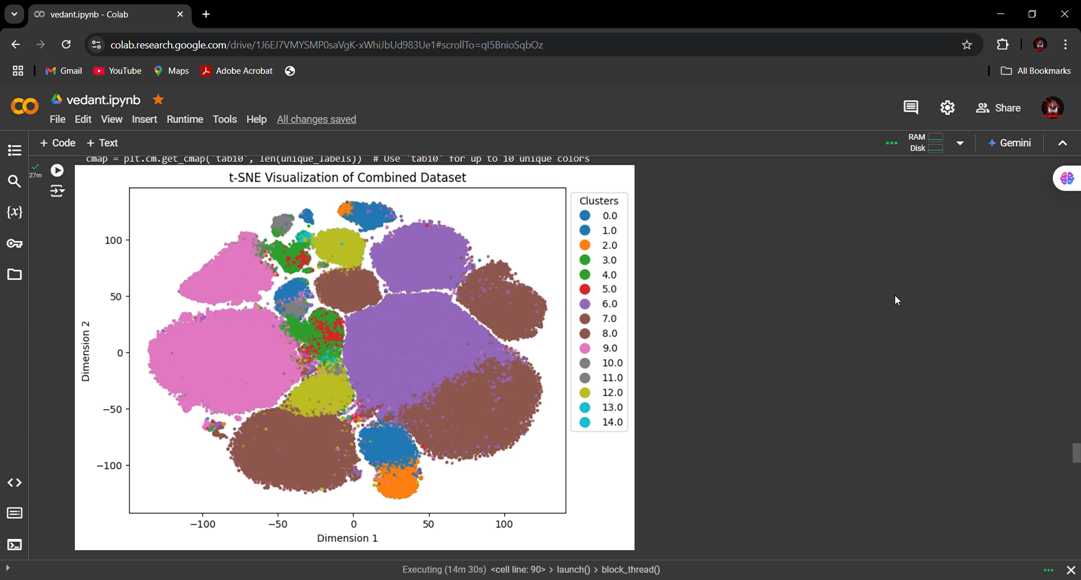
Thank You

